Slide 1

Some Revenue Management acronyms explained

Slide 2

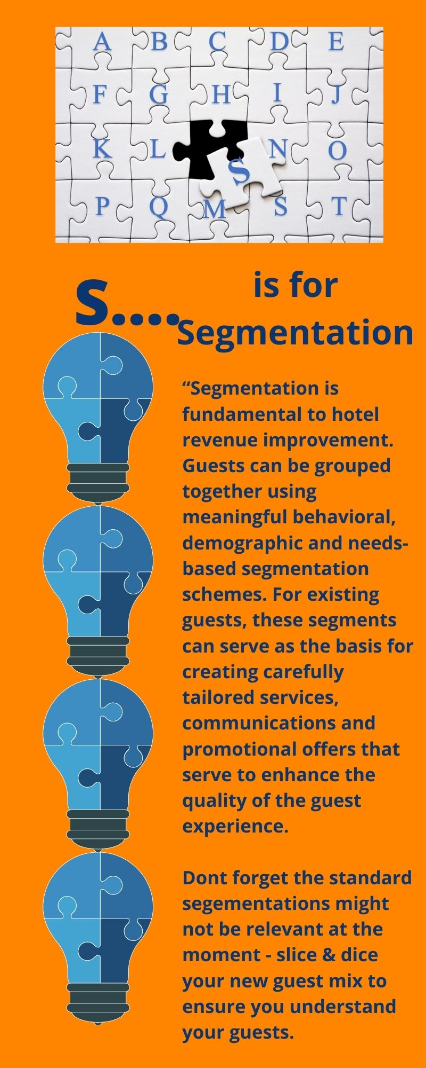

Slide 3



Slide 4

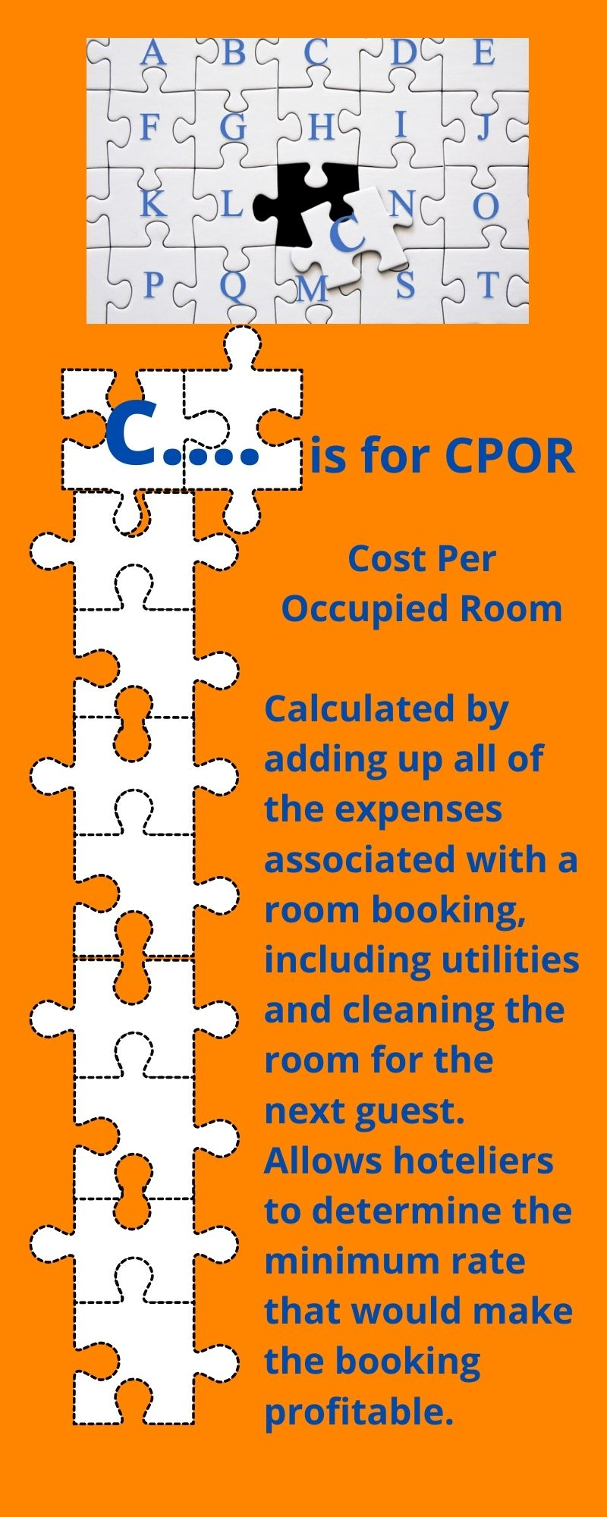

Slide 5
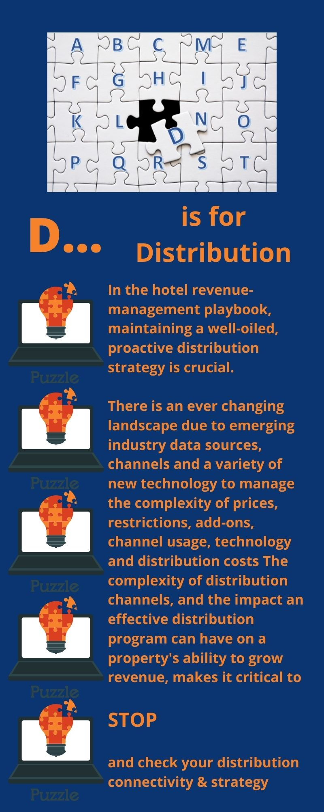


Slide 6


Slide 7


Slide 8


Slide 9


Slide 10
